Slide 1
EE/CE 252/251
Signals and Systems
with
Dr. Naveed R. Butt
@
Habib University

Slide 2
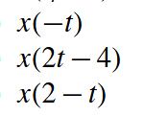
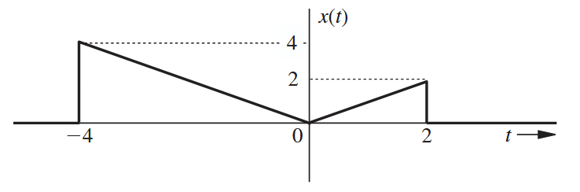
Problem 1
For the signal shown plot the following

Slide 3
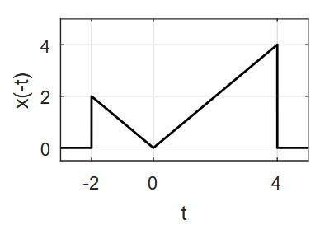
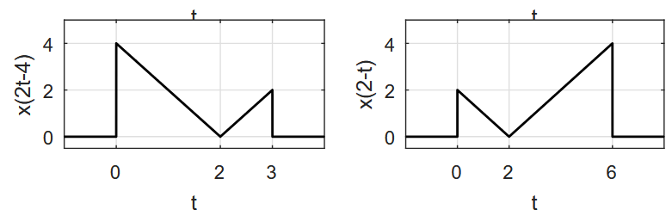
Solution

Slide 4
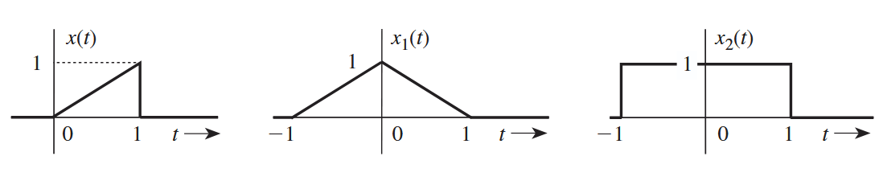

Problem 2
Write $x_{1}, x_{2}$ in terms of $x$

Slide 5
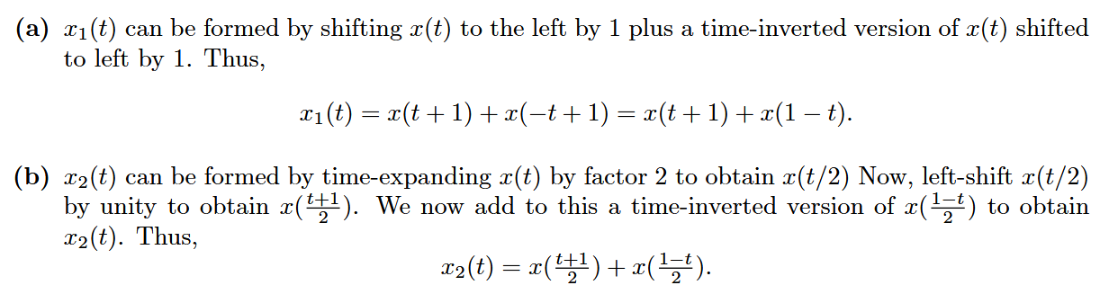
Solution

Slide 6
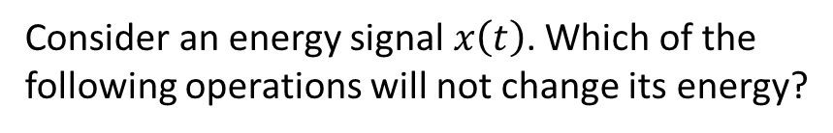
Problem 3
Consider an energy signal $x\left(t\right)$. Which of the following operations will not change its energy?
Time-shifting
Time-reversal
Time-compression
Time-expansion
Amplitude-scaling
Justify your claims.

Slide 7
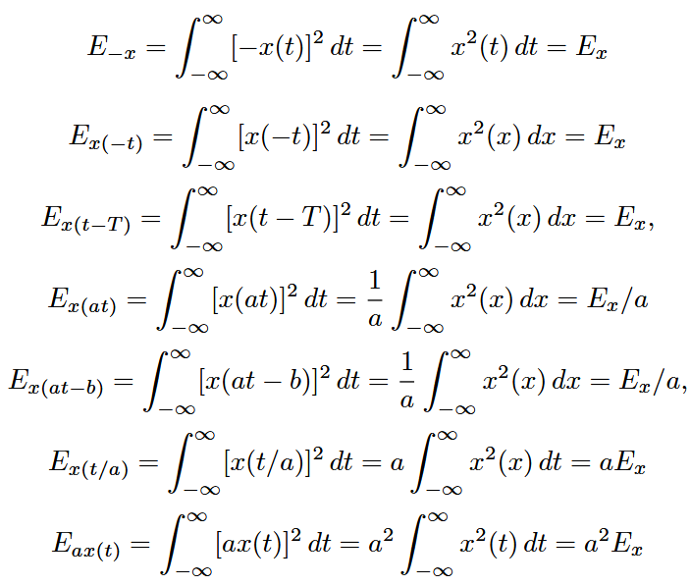
Solution

Slide 8
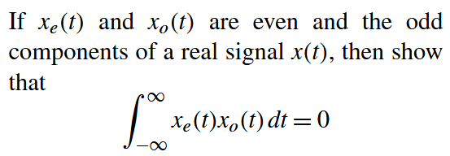
Problem 4

Slide 9
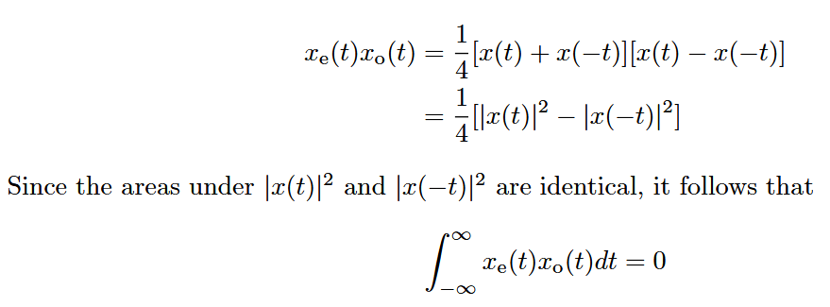
Solution

Slide 10
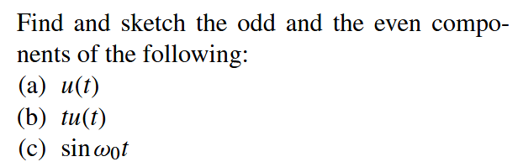
Problem 5

Slide 11
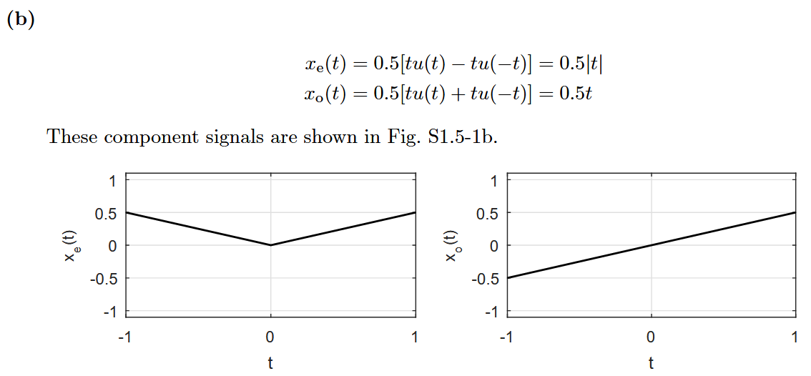
Solution

Slide 12
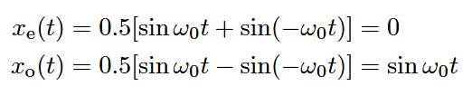
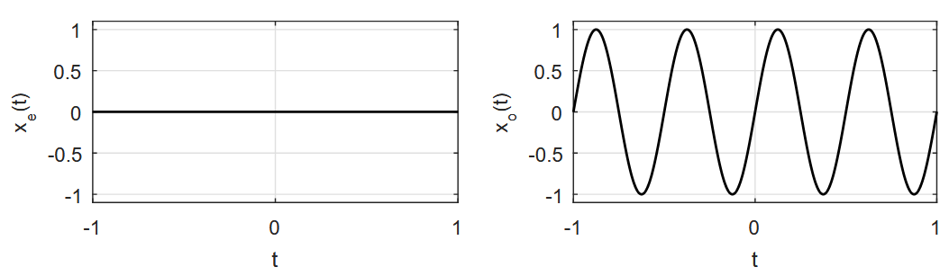
Solution

Slide 13

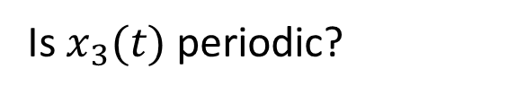
Problem 6
Is $x_{3}(t)$ periodic?

Slide 14

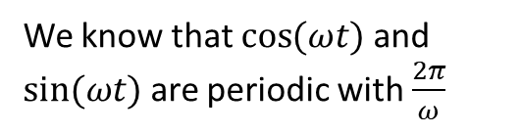


Solution
We know that $\cos{(ωt)}$ and $sin⁡(ωt)$ are periodic with $\frac{2π}{ω}$
For the sum of two signals to be periodic
Both signals must be periodic
Their periods must have an LCM (i.e., ratio of the periods should be rational).
  If the above hold, the LCM is the period of the sum.
Therefore $T_{1}=2π$ and $T_{2}=2$
$\frac{T_{1}}{T_{2}}=π$ which is not rational.
Therefore $x_{3}(t)$ is not periodic.

Slide 15
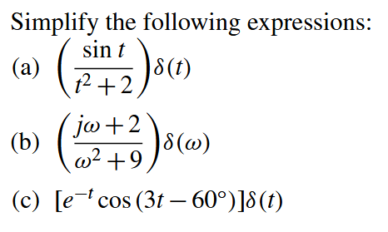
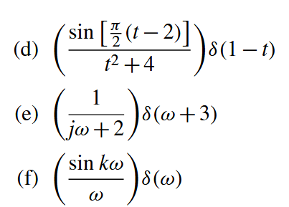
Problem 7

Slide 16
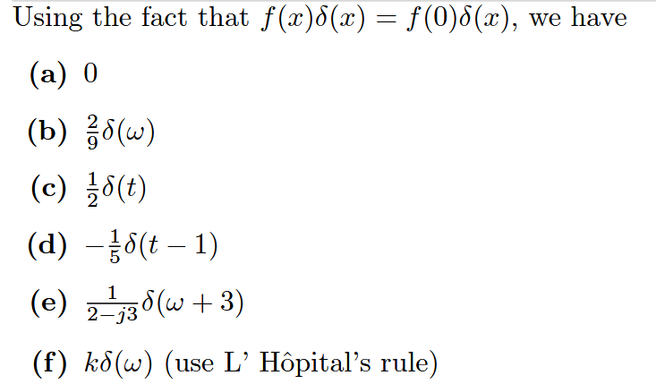
Solution

Slide 17
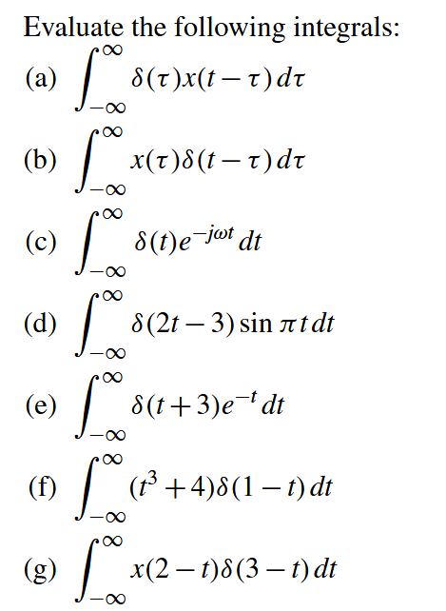
Problem 8

Slide 18
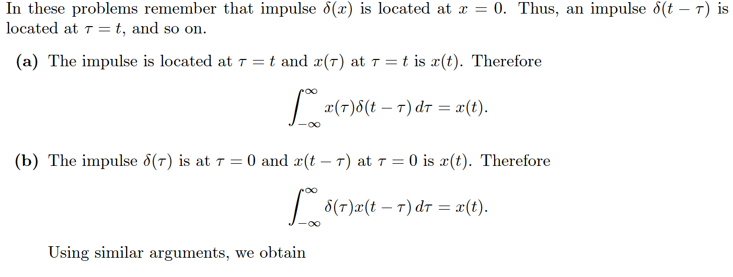
Solution

Slide 19
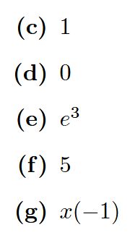
Solution

Slide 20
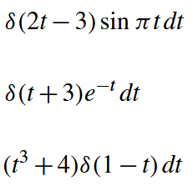
Problem 9
Find area under the given functions for $−2<t<3$

Slide 21

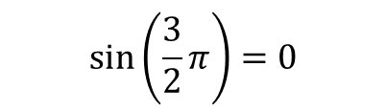
Solution
$$\sin\left(\frac{3}{2}π\right)=0$$
0 (since impulse is not within region of integration)
$$1^{3}+4=5$$

Slide 22

Problem 10
Is this a power or energy signal? Find both.

Slide 23
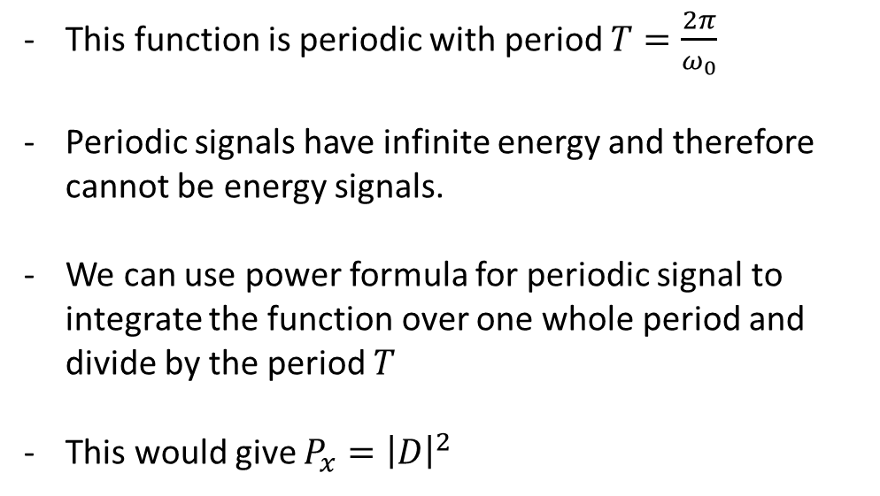
Solution
This function is periodic with period $T=\frac{2π}{ω_{0}}$
Periodic signals have infinite energy and therefore cannot be energy signals.
We can use power formula for periodic signal to integrate the function over one whole period and divide by the period $T$
This would give $P_{x}={\left|D\right|}^{2}$

Slide 24
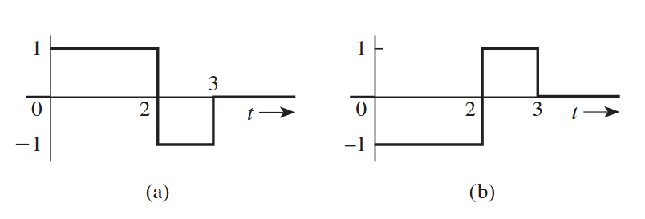
Are the following signals energy signals or power signals? Find their energy and power.
Problem 11

Slide 25
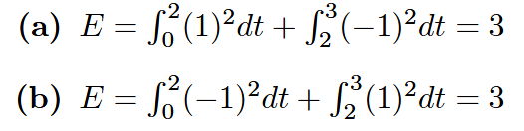
Solution
Both are energy signals as their energies are finite.
Power of an energy signal is always zero.

Slide 26


Questions?? Thoughts??

